Slide 1

Supply Chain Analysis

Slide 2
Agenda
Project Recap
Data Attributes
Process
Insights
Summary

Slide 3

Project Recap
Supply chain dataset from our client, comprises 24 columns, 100 rows containing information about Product type, SKU, Price, Availability, Number of products sold, Revenue generated, Customer demographics, stock levels, lead times, order quantities, shipping times, shipping carriers, shipping costs, supplier name, location, lead time, production volumes, manufacturing lead time, manufacturing costs, inspection results, defect rates, transportation modes, routes, costs.

Slide 4


Primary goal
The supply chain dataset presents a comprehensive set of information related to product sales, manufacturing, and logistics. The challenge is to extract meaningful insights and actionable recommendations from the data to optimize supply chain operations and improve profitability.

Slide 5
Data Attributes
Product type: The type or category of the product being sold, which could include classifications such as electronics, clothing, household goods, etc.
SKU: Stock Keeping Unit, a unique code assigned to each distinct product or item for inventory tracking and management.
Price: The price of the product, typically in the currency of the country where the purchase is made (e.g., USD for United States).
Availability: Indicates whether the product is currently available for purchase or out of stock.
Number of products sold: The quantity of the product sold in a specific period, such as daily, monthly, or yearly.
Revenue generated: The total amount of revenue generated from selling the product, calculated by multiplying the price by the number of products sold.
Customer demographics: Information about the customers' characteristics and attributes, such as age, gender, income level, etc.
Stock levels: The quantity of the product available in inventory at a given time.
Lead times: The time it takes from placing an order until the product is delivered to the customer.
Order quantities: The number of units of the product ordered by customers in each transaction.
Shipping times: The time it takes for the product to be shipped from the seller to the customer's location.

Slide 6
Data Attributes
12. Shipping carriers: The companies or services responsible for transporting the product from the seller to the customer.
13. Shipping costs: The expenses associated with shipping the product to the customer, including packaging, handling, and transportation fees.
14. Supplier name: The name of the company or entity that supplies the product to the seller.
15. Manufacturing lead time: The time it takes to manufacture the product from the time the order is placed until it is ready for shipment.
16. Production volumes: The quantity of products produced by the manufacturer within a specific timeframe.
17. Manufacturing costs: The expenses incurred in the process of manufacturing the product, including materials, labor, and overhead costs.
18. Inspection results: The outcomes of quality control inspections performed on the product during or after

Slide 7
Process
Data fetching
Data preparation
Data visualization

Slide 8

1) Data fetching
We can collect the dataset from different platforms, here we are fetching from phpadmin, it’s a web-based tool used to manage MySQL.
We can export the data from the tool by using the credentials given.

Slide 9
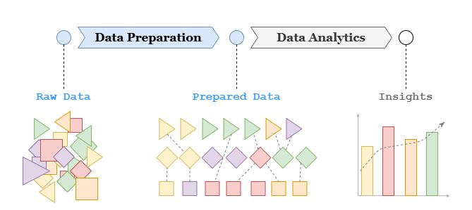
2) Data Preparation
Data preparation is the process of cleaning, transforming & organizing raw data into usable format for analysis. It ensures data quality and consistency, which are crucial for generating accurate and reliable insights.
Our data has 24 columns and 100 rows, we used power query editor to check for errors, any duplicate fields or any blank records.
For secondary confirmation, we also wrote in python to maintain quality data.

Slide 10
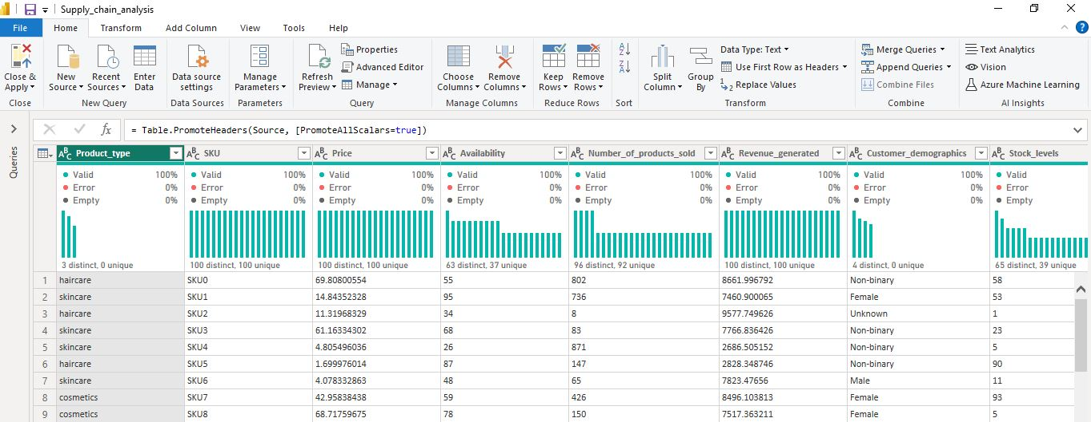
Power query editor

Slide 11

3) Data Visualization

Slide 12
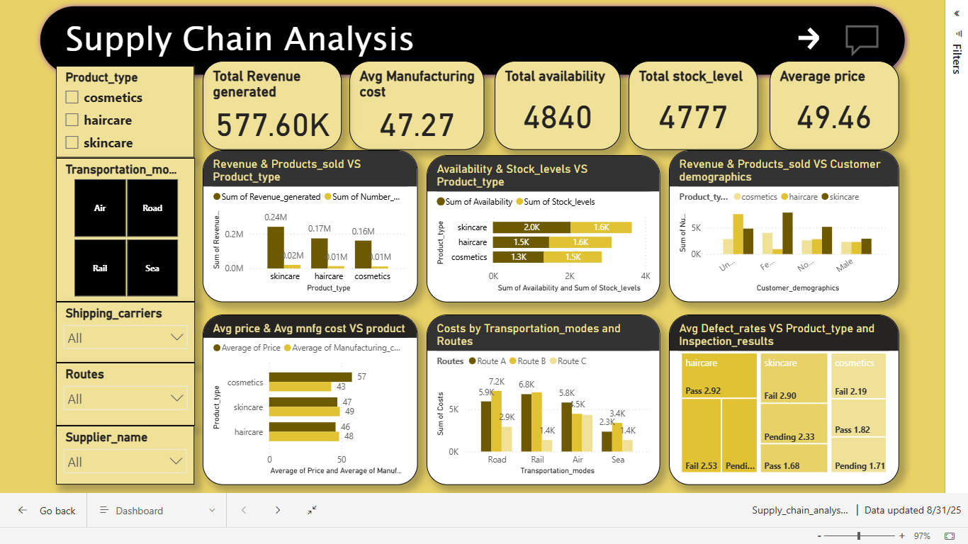
Dashboard

Slide 13
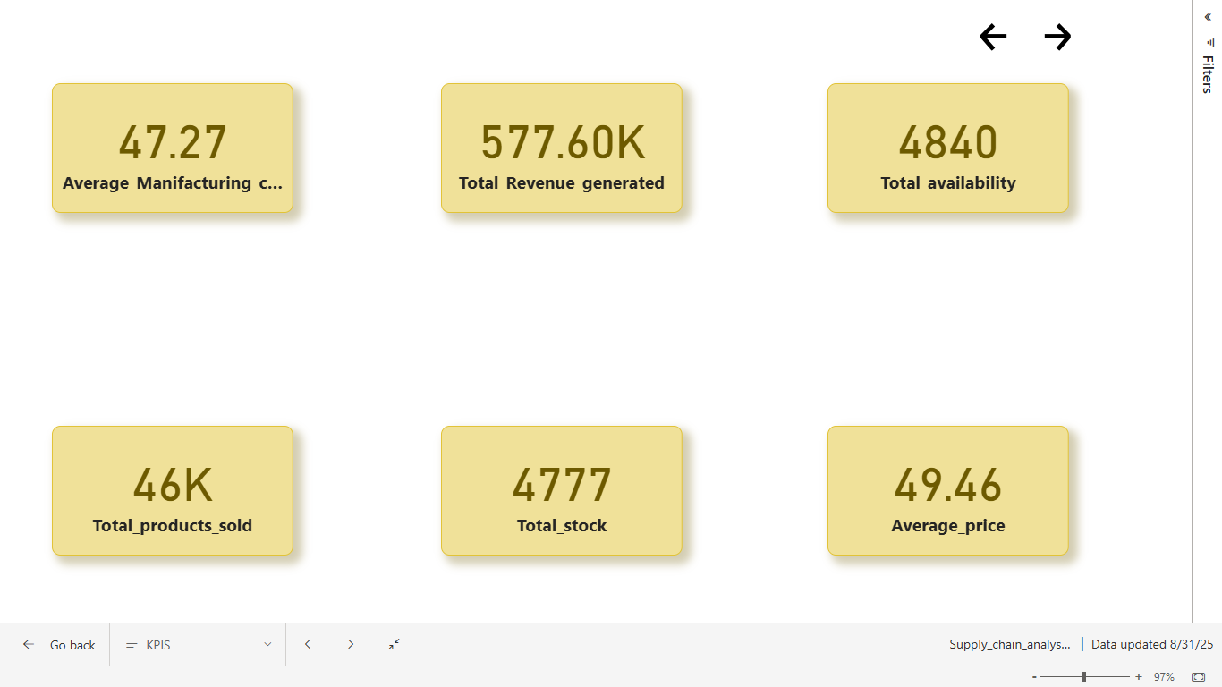
KPI

Slide 14
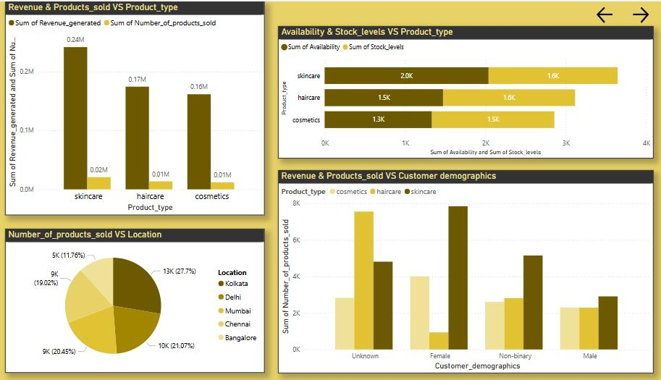
Sales Analysis

Slide 15
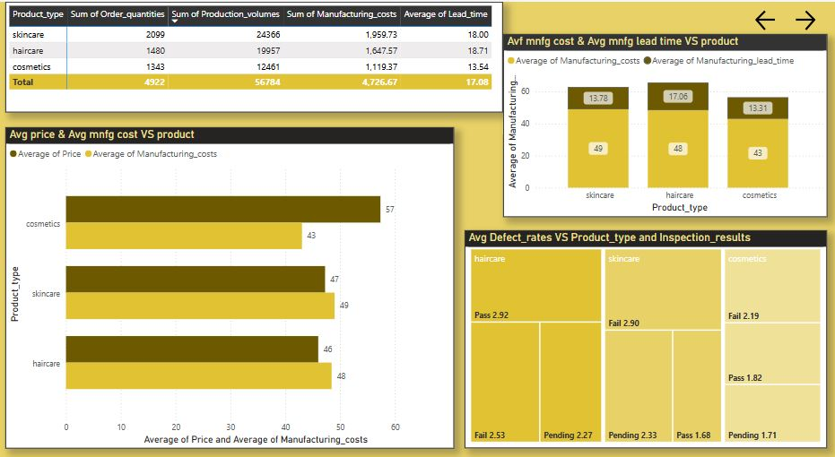
Operational Analysis

Slide 16
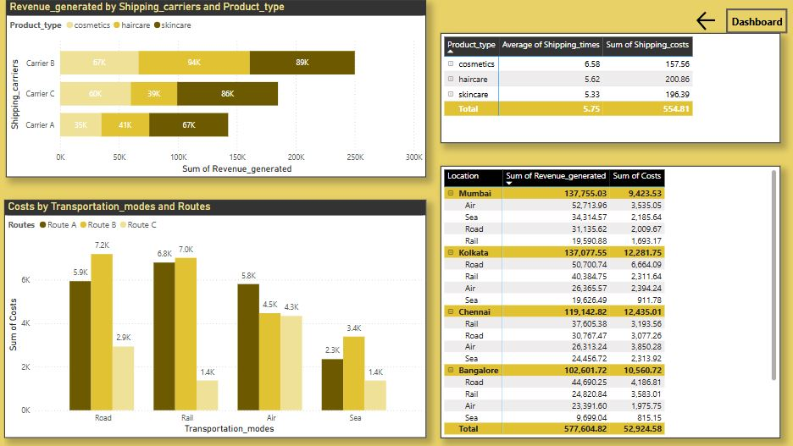
Shipping Analysis

Slide 17

Insights
Skincare products are the most profitable, haircare come next, followed by cosmetics.
Among four transportation modes(air, road, rail, sea) sea mode offers more economical solution with respective to shipping costs.
Top locations with highest number of products sold are Kolkata and Delhi, closely followed by Mumbai and Chennai. In contrary, Bangalore has the least number of products sold.
Manufacturing costs for skincare if higher compared to haircare and cosmetics
Considering customer demographics, an unknown category purchased a higher quantity for all three product types. Skincare is the most popular with high demand.

Slide 18


Summary
Total revenue reached 577.6K with an average manufacturing cost of 47.27 and a selling price of 49.46. Skincare products show strong stock performance, while transportation costs—especially on Route B—present optimization opportunities. Variations in defect rates highlight the need to strengthen quality control, particularly for skincare.
Recommendations:
Optimize costly shipping routes.
Enhance quality checks for skincare products.
Apply successful inventory strategies across all product lines.
Explore pricing adjustments to boost margins.
Tailor marketing to top-performing customer demographics.

Slide 19




Thank you Would love to hear your opinions and suggestions

